Slide 1
LAN - WAN / INTERNET SERVICES

Slide 2
Introduction
Network interconnection components
LANs
WANs
Internet Services

Slide 3
Network Interconnection Components
Networks can be connected to each other through several components
Hub/Repeater
Switch
Router
Gateway

Slide 4
Hub/Repeater
Hub is a device for connecting multiple Ethernet devices together and making them act as a single network segment
Layer 1 of the “OSI model”
Network A
Network B
Higher
Layers
Higher
Layers
Hub
Physical
Physical
Physical

Slide 5
Switch
A network switch is a computer networking device that links network segments or network devices
Layer 2 of the “OSI model”
Node in Network A
Node in Network B
Higher
Layers
Higher
Layers
Switch
Data Link
23-01-88-A8-77-45
Data Link
53-F1-A4-AB-67-4F
Data Link
Data Link
Physical
Physical 1
Physical 2
Physical

Slide 6
Router
Connects 2 or more networks and uses network layer addresses (like IP address) to make data forwarding decisions
Layer 3 of the “OSI model”
A node in Network A
A node in Network B
Higher
Layers
Higher
Layers
Router
Network
137.22.144.6
Network
145.65.23.102
Network
Network
Data Link
Data Link
Data Link
Data Link
Physical
Physical 1
Physical 2
Physical

Slide 7
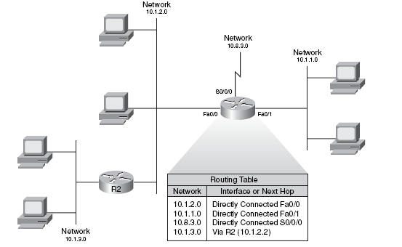
Routing table
Router builds routing table to identify knows network and know how to reach them

Slide 8
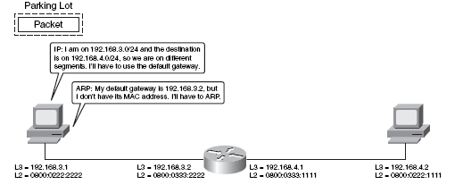
Default gateway

Slide 9
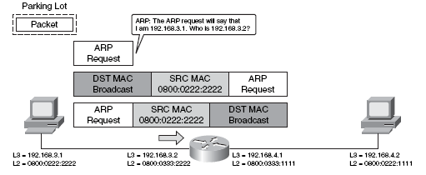
ARP request to router

Slide 10
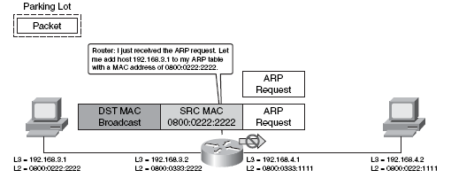
ARP reply from router

Slide 11
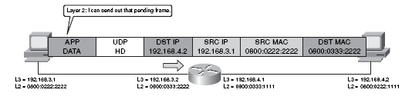
Send data frame to router

Slide 12
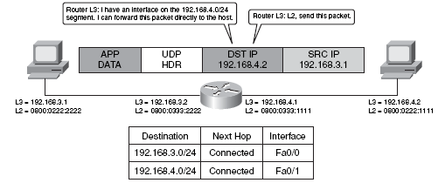
Routing table lookup

Slide 13
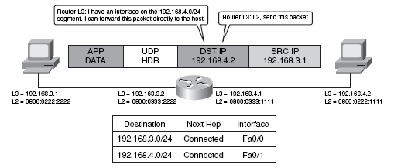
Router send ARP request

Slide 14
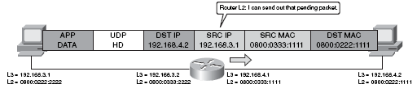
Router send frame to the destination host

Slide 15
Gateway
Connects 2 or more networks that can be of different types and provides protocol conversion so that end devices with dissimilar protocol architectures can interoperate
137.22.144.6
Netware
Gateway
TCP/IP
145.65.23.102

Slide 16
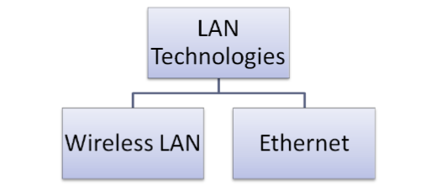
Local Area Network (LAN)
Small geographic area (e.g. room, office)
Contrast to wide-area networks (WANs)
Controlled by one administrative authority
High speed
Notes:
Lesson descriptions should be brief.

Slide 17
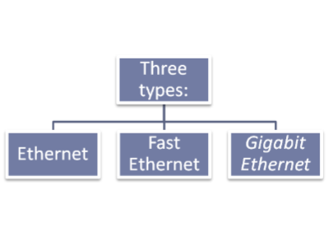
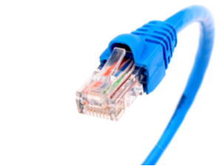
Ethernet
Standardized as IEEE 802.3
Using twisted pair cable (RJ-45)
Notes:
Lesson descriptions should be brief.

Slide 18
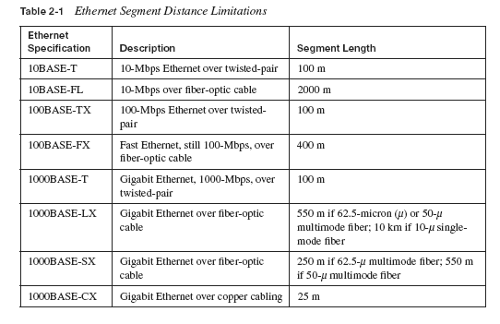
Segment Length
Notes:
Lesson descriptions should be brief.

Slide 19
CSMA/CD
Usually used in a bus topology
Used in Ethernet LAN’s
Unlike the token ring, all nodes can send whenever they have data to transmit
When a node wants to transmit information, it first “listens” to the network. If no one is transmitting over the network, the node begins transmission
It is however possible for two nodes to transmit simultaneously thinking that the network is clear
When two nodes transmit at the same time, a collision occurs
The first station to detect the collision sends a jam signal into the network
Both nodes back off, wait for a random period of time and then re-transmit

Slide 20
CSMA/CD
A
B
C
D
A
B
C
D
A
B
C
D
Collision

Slide 21
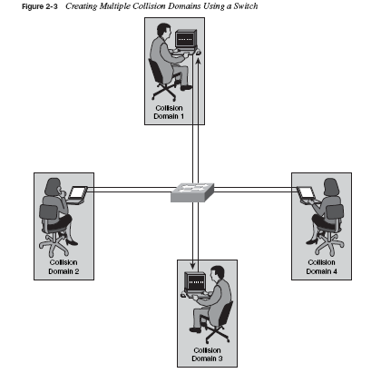
Create multiple Collision domain with Switch

Slide 22
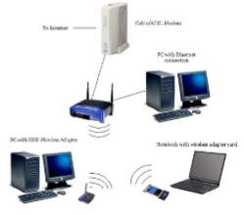
Wireless network: Wi-fi
Cheap networking solution
Radio waves instead of cables
Four standards:
802.11a
802.11b
802.11g
802.11n
2 mode: infrastructure and Ad-hoc

Slide 23
Types of Networks
Models vary according to:
Computer positioning
Control levels over shared resources
Communication and resource sharing schemes
Network models
Peer-to-Peer
Client/server

Slide 24
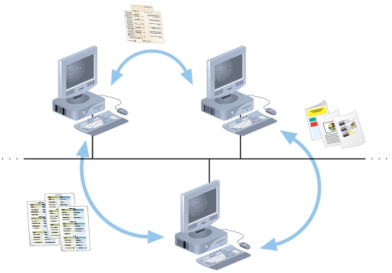
Peer-to-Peer Network
Figure 1-1 Resource sharing on a simple peer-to-peer network
Notes:
Typical in a home with several computers
Direct computer communication
Equal authority
Individual resource sharing
May share resources
May prevent access to resources
Each computer can send data to every other computer on the network
Advantages
Simple configuration
Inexpensive to set up
Disadvantages
Not flexible
Not necessarily secure
Not practical for large installations
Resource sharing method
Modify file sharing controls
A user responsibility
Not centrally controlled
Potential variations and security issues
Environments
Small home or office
Large networks using the Internet
Gnutella, Freenet, original Napster
BitTorrent software

Slide 25
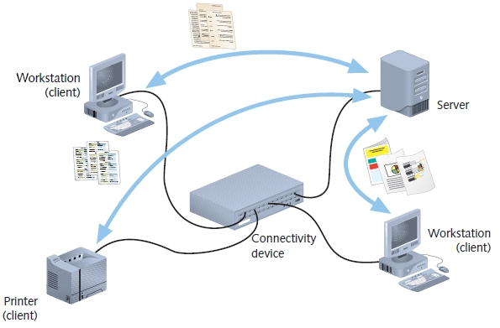
Client/Server Networks
Figure 1-2 Resource sharing on a client/server network
Notes:
Central computer (server)
Facilitates communication and resource sharing
Clients (other computers)
Personal computers
Known as workstations
Central resource sharing controlled by server
Data sharing, data storage space, devices
No direct sharing of client resources
Computer roles
Server
Clients
Run local applications
Store data locally
Use server shared applications, data, devices
Use server as intermediary
Communication
Switches or routers
Server requirement
Network operating system
Manages client data, resources
Ensures authorized user access
Controls user file access
Restricts user network access
Dictates computer communication rules
Supplies application to clients
Server examples
UNIX, Linux, Microsoft Server 2003 and 2008, MAC OS X Server

Slide 26
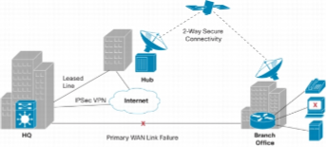
Wide Area Network (WAN)
Computer network that covers a broad area
Crosses metropolitan, regional, or national boundaries
Using routers and public communications links
Example: Internet

Slide 27
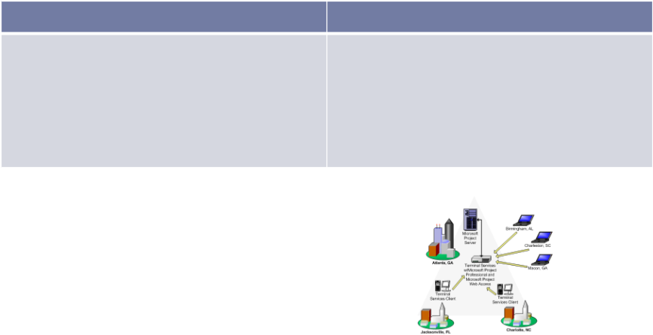
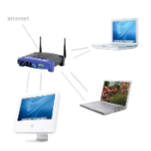
LAN & WAN comparison
LAN
WAN
Small area covered
Use public communication links
Usually low speed
Uses Wi-Fi, Ethernet cables
Large area area covered
Use public communication links
Usually fast speed
Uses optic wires, microwaves, satellites

Slide 28

Internet
Global system of interconnected computer networks.
Consists of millions of private and public networks

Slide 29
Internet functions
Email
File sharing
Instant messaging
World wide web
Voice over IP

Slide 30
Email
Email is one of the most widely used and regarded network services
Common server software
Zimbra
Exchange
Lotus Notes
Postfix

Slide 31
Email Protocols
Use two Transmission Control Protocol / Internet Protocol (TCP/IP) to send and receive messages
Simple Mail Transfer Protocol (SMTP) handles outgoing mail
Post Office Protocol (POP3) handles incoming mail
The SMTP server on most machines uses send mail to do the actual sending; this queue is called the send mail queue

Slide 32
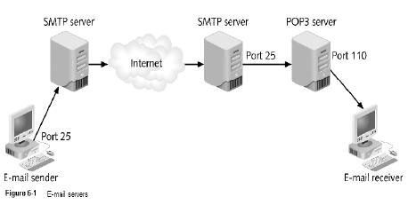
Email Protocols

Slide 33
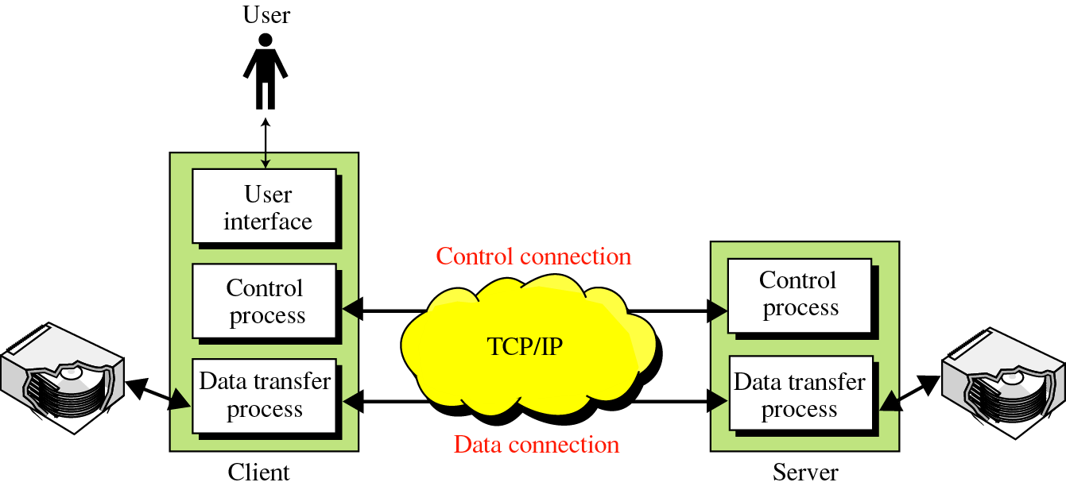
File Transfer Protocol (FTP)
FTP uses the services of TCP.
Port 21: is used for the control connection
Port 20 for the data connection

Slide 34

Web Servers
A web server can be:
A computer program
Responsible for accepting HTTP requests from clients (web browsers)
Returns HTTP responses with optional data contents
Usually web pages
HTML documents
Linked objects (images, etc.).
A computer that runs a computer program which provides the above functionality

Slide 35
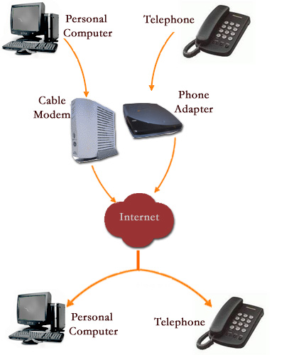
VoIP
VoIP is the Voice over Internet Protocol.

Slide 36
VoIP
The Voice over Internet Protocol enables you to use your IP network to make phone calls.
However, it is not just used for phone calls, it is used for general voice communications over the internet.

Slide 37
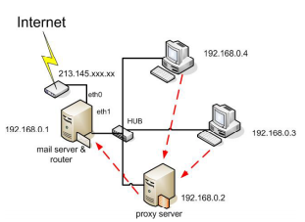
Proxy Server
Proxy servers is a server, which acts as an intermediary between internal users and external host
Proxy server protects and hides the computer from the outside network
In concentrates on the port that monitors the incoming and outgoing traffic of each port
Proxy server can also be used for the filtering of the request

Slide 38
Domain Name System (DNS)
Internet users use to reference anything by name on the Internet
The mechanism by which Internet software translates names to addresses and vice versa

Slide 39
The Name Space
The name space is the structure of the DNS database
An inverted tree with the root node at the top
Each node has a label
The root node has a null label, written as “”

Slide 40
Domain Names
A domain name is the sequence of labels from a node to the root, separated by dots (“.”s), read left to right
The name space has a maximum depth of 127 levels
Domain names are limited to 255 characters in length
A node’s domain name identifies its position in the name space

